Slide 1


Daily Caffiene Dose
By Khush Dadhania

Slide 2

A friend with coffee is a friend indeed
Coffee. Says not found. User startup disabled.
“Adventure in life is good…consistency in coffee, even better.
Always make time for the thing you love, like drinking coffee.
Support your local caffeine dealers.

Slide 3
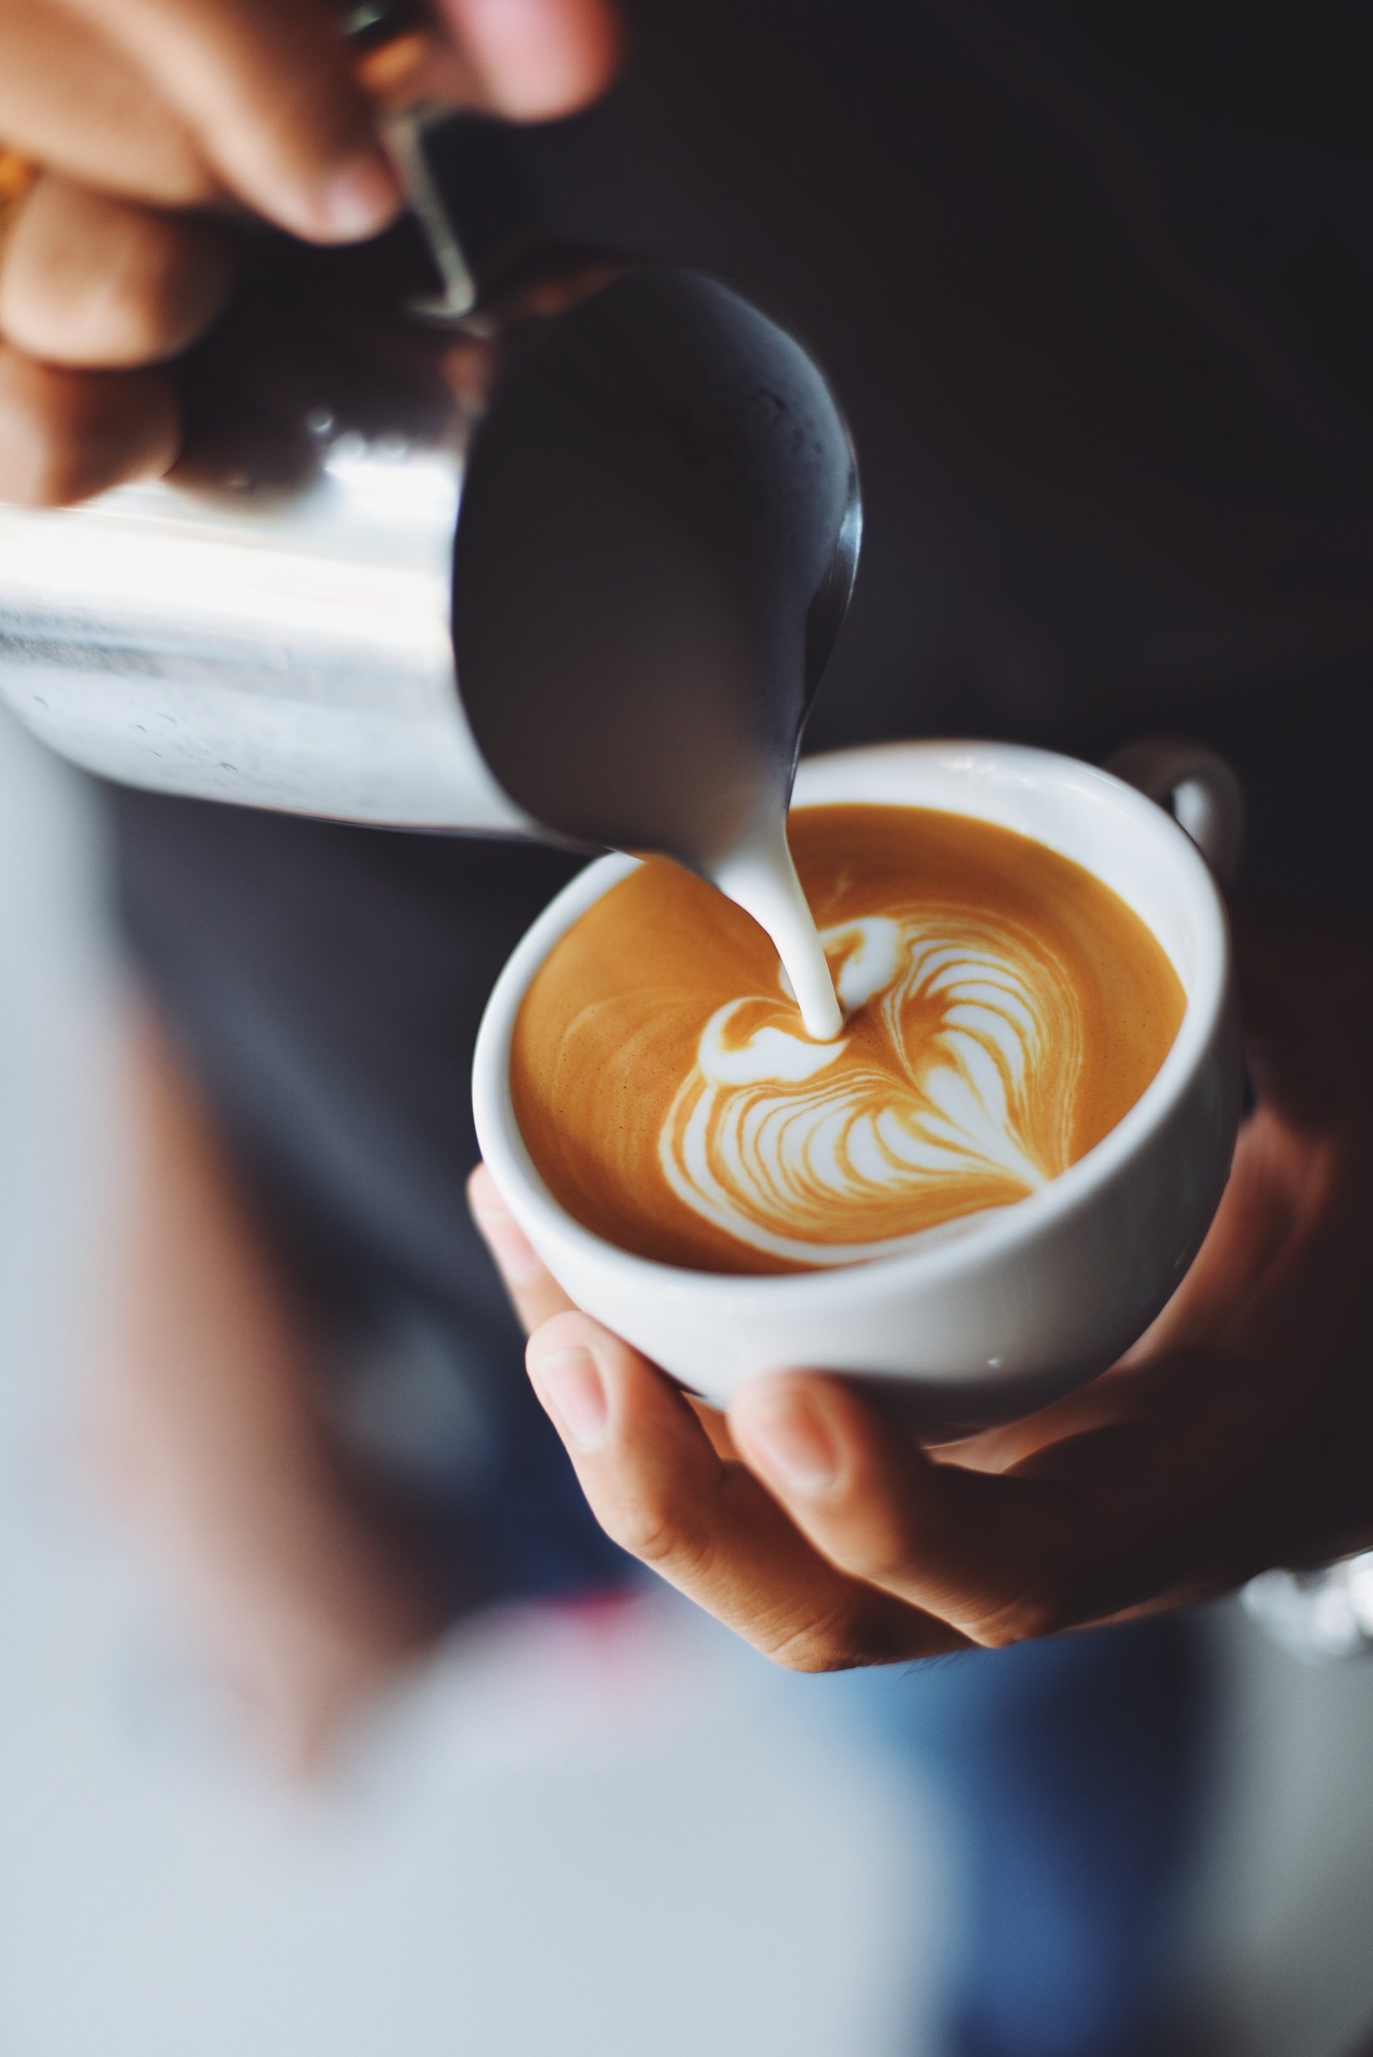
WINTER IS TIME FOR HOT,STEAMY PEPPERMINT MOHAS.
YOU FEEL THE NEED TO DOCUMENTNYOUE COFFEE RUNS WITH AN INSTAGRAM PIC OF COURCE…..
NOTHING REALLY COMPARES TO THE ELATION YOU FEEL WHILE HOLDIND YOUR FIRST CUP OF JOY OF THE MORNING.

Slide 4
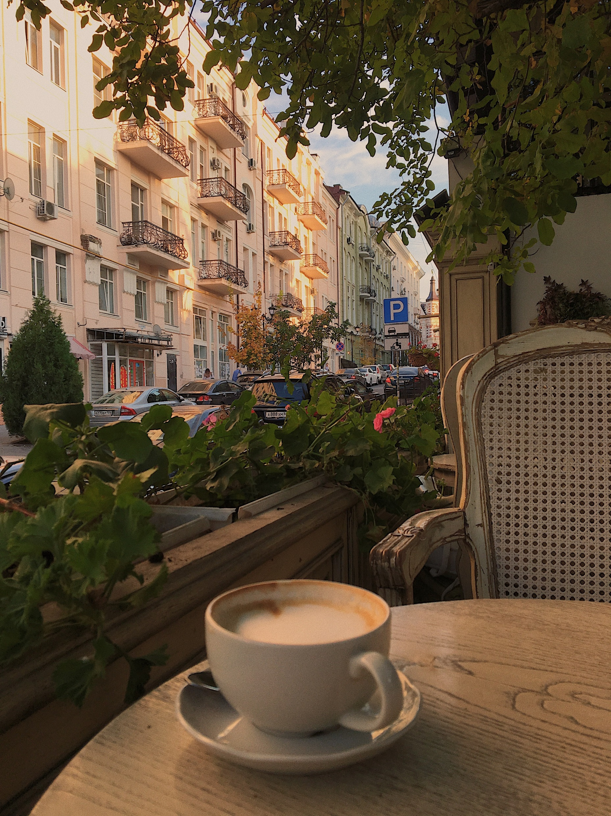

SPRINGS BRINGS US GROWTH AND LAVENDER LATTES.

Slide 5
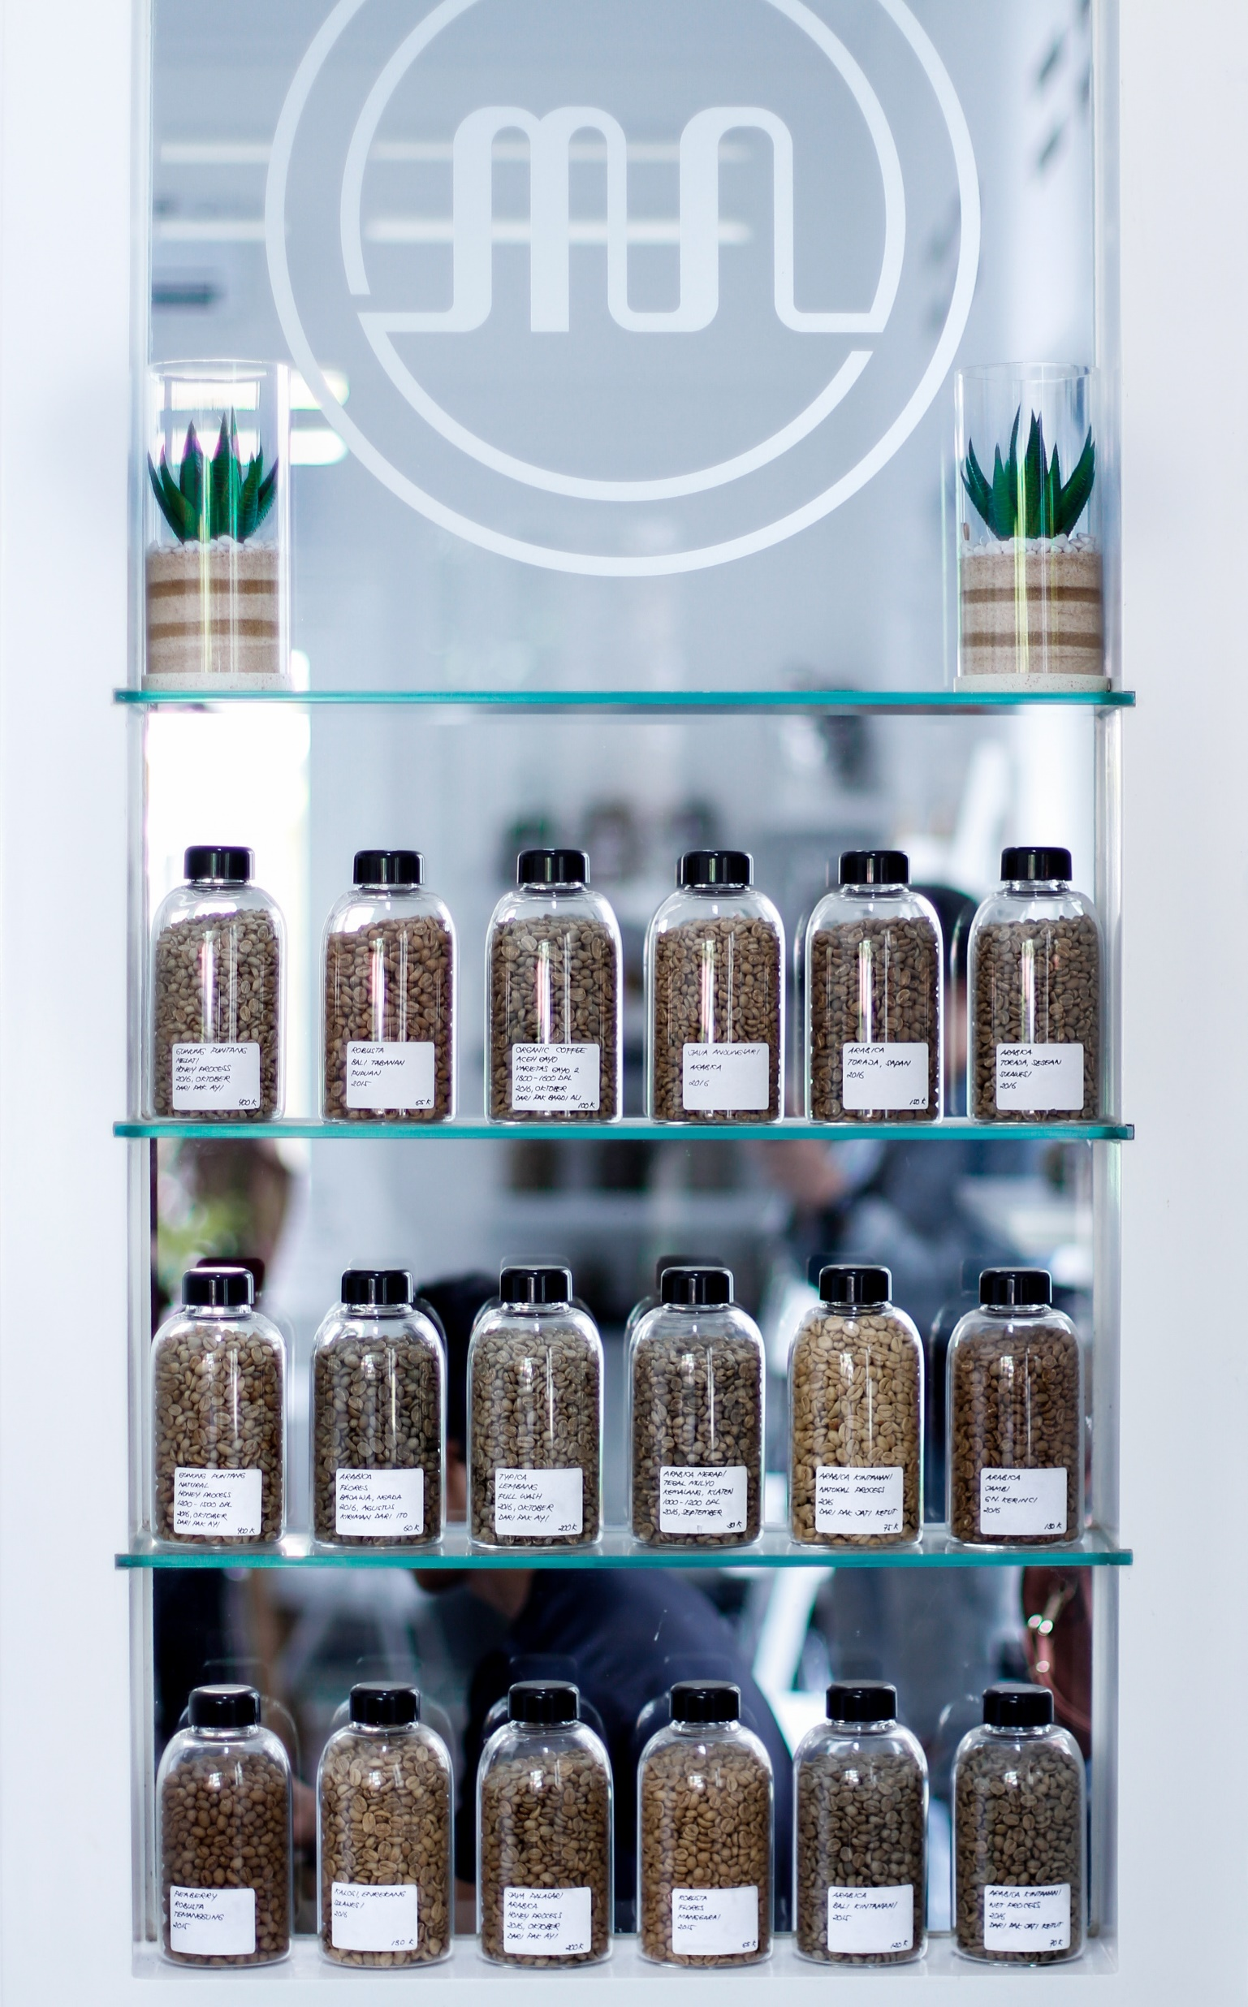
YOUR LOCAL BARISTAS DON’T ASK FOR YOUR NAME ANYMORE,AND THEY EVEN KNOW YOUR ORDER BY HEART.

Slide 6
Thank you

